Slide 1
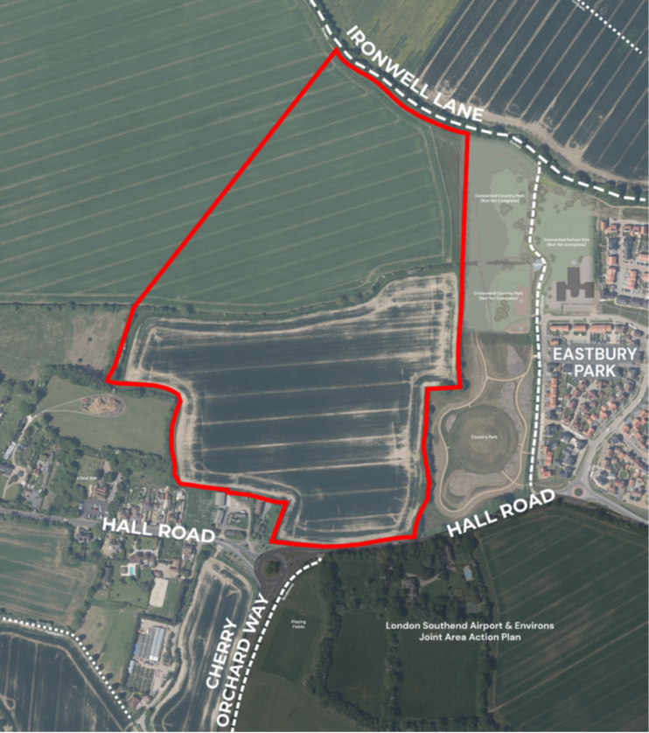
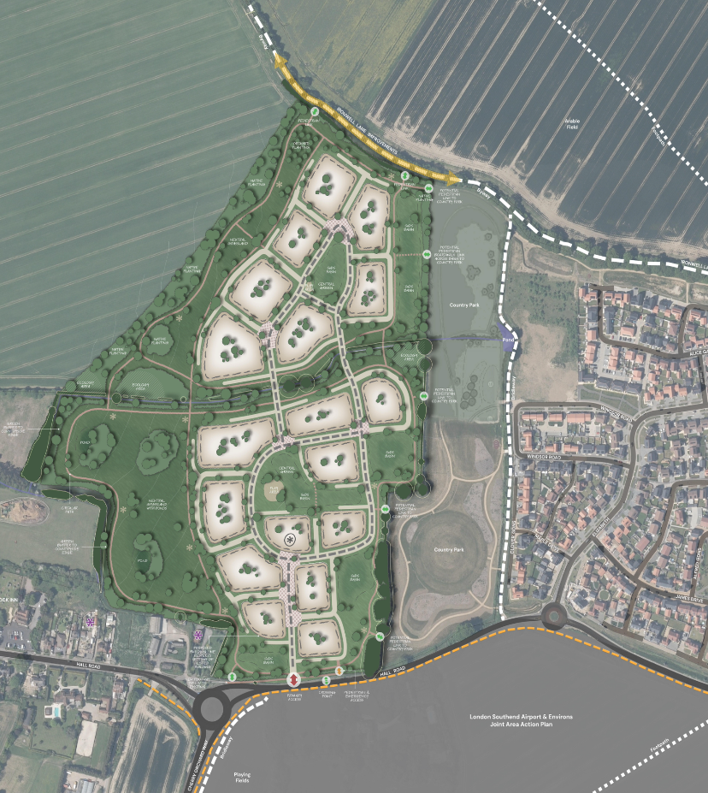
news
HALL ROAD, ROCHFORD
December 2025
Welcome to our Winter newsletter from Croudace Homes to keep you updated on our plans for a new neighbourhood at land north of Hall Road in Rochford.
COMMUNITY CONSULATION UPDATE
Thank you to everyone who attended our consultation event in Rochford in January and to those who shared their views via the council’s website.
Your feedback has been invaluable in helping shape the future of our community, and we truly appreciate the time and thought you put into your comments.
Over the past few weeks, we’ve carefully reviewed all submissions and addressed the key points raised. In this newsletter, you’ll find a “You Said” section summarising the main themes from your feedback.
Want to see our full responses and the actions we’re taking?
Visit the Urbanissta website and head to the Access page, where you’ll find the Rochford consultation. There, we’ve published all replies to comments and questions.
www.urbanissta.co.uk
croudacehomes.co.uk

Slide 2
news
December 2025
You said…
Concerns around building on Green Belt and Environmental matters.
Comments Included:
Objections to building on Metropolitan Green Belt land
Concerns about urban sprawl
Wildlife and biodiversity impacts
Risks of flooding and surface water drainage
You said…
Concerns on roads, impact on public services and utilities and emergency access
You said…
Concerns on the local infrastructure
Comments Included:
Hall Road and surrounding routes already congested
Schools, GP surgeries, dentists, and hospitals are at or beyond capacity
Water supply and sewage systems under severe strain
Inadequate provision for emergency vehicles.
You said…
Concerns on Community and Social Impact
Comments Included
Concerns about crime prevention
Residents are concerned that the cumulative impact of multiple developments (Hall Road, Mount Bovers, Ashingdon) are being ignored.
Fear of overdevelopment leading to loss of identity, mental health impacts, and increased antisocial behaviour.
All your comments are addressed on the Urbanissta website.
https://www.urbanissta.co.uk/public-access/hall-road-rochford
Stay informed about the next steps.
croudacehomes.co.uk

