Slide 1
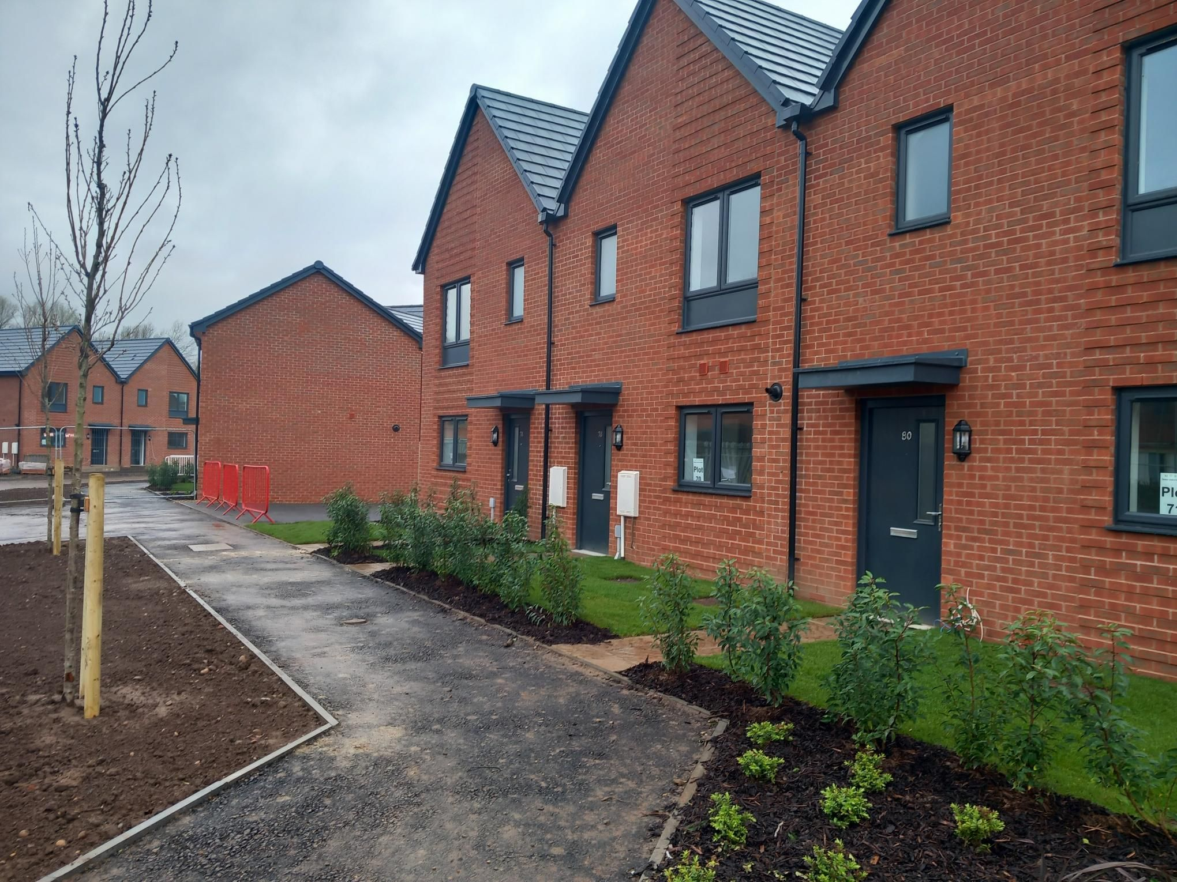
Morro Partnerships
Community Newsletter
AUTUMN 2024
House Type Image. Credit: Morro Partnerships Abbey Park Road Development
Welcome
Welcome to Morro Partnerships news, this is our Community Newsletter informing you first on proposals for a new development on brownfield land at Newlyn Road Cradley Heath. It aims to keep residents updated on our latest plans for a new community on this site.
Our Plans
We are preparing to submit a full planning application for the development of up to 46 homes on a brownfield commercial site located on Newlyn Road, Cradley Heath. This project focuses on delivering affordable rental homes, helping to meet the urgent need for accessible housing within the local community.
We’d like to know your views on the development details and so we are setting out some information below.
About Us
Morro’s founding aim is to work with local authorities and housing providers to uncover key regeneration sites to provide a mix of property types to the benefit of local communities and their wider cities. For over 30 years, we have proudly been undertaking refurbishment and regeneration schemes for affordable and private houses. As a privately owned company, we strive to develop properties that are built to last and made to instantly feel like home.
We put ourselves into our customers’ shoes and get to know their wants and needs on a personal level to guarantee we build the best. With decades under our belt, we have become experts in knowing what residents, local authorities and social landlords need from their properties. It also means our wide knowledge and understanding of regional authority planning strategies and policies and local land conditions are second to none.
Forward Thinking Communications

Slide 2
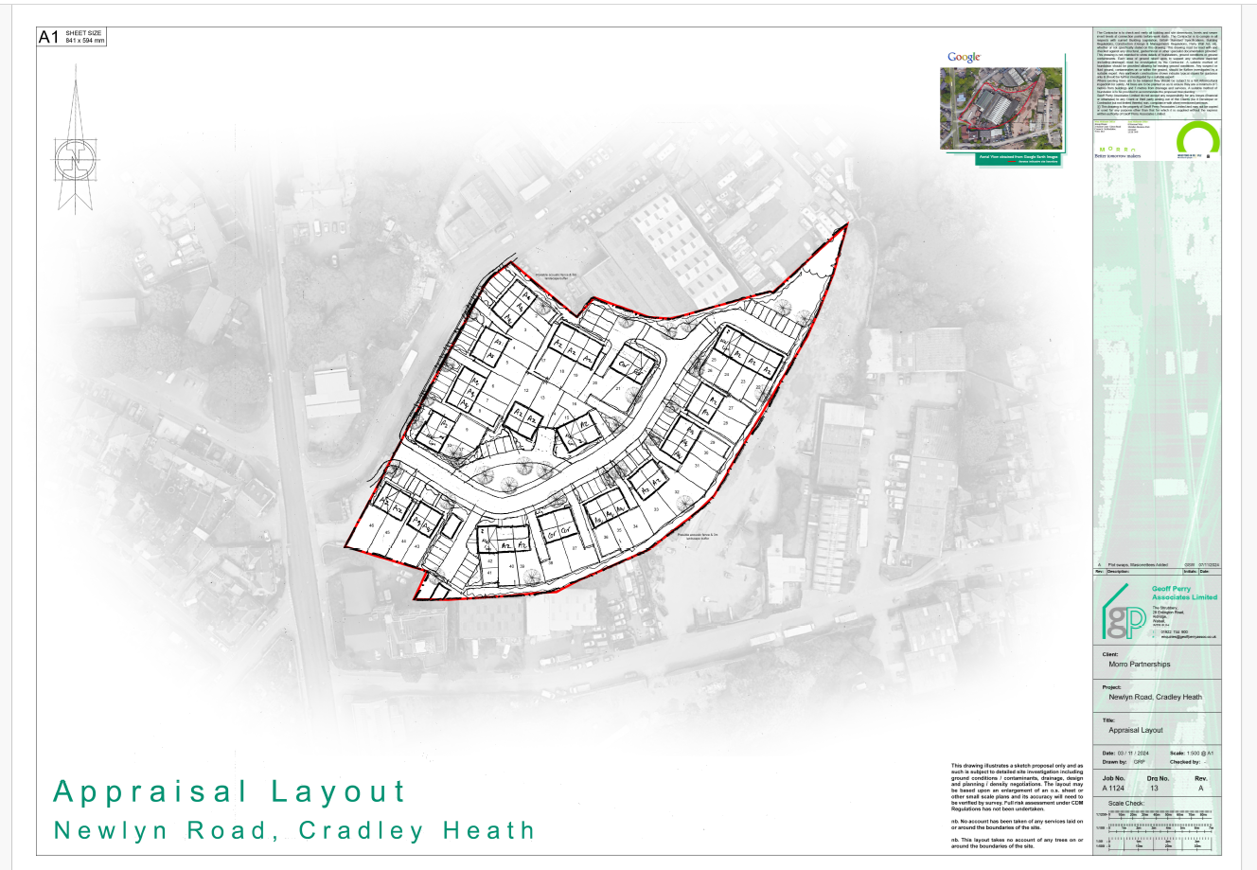
Morro Partnerships
Community Newsletter
AUTUMN 2024
SUMMER 2024
Our Proposed Site Layout
GPA to provide without schedule on plan
Image: Geoff Perry Associates
Our Proposed Layout….
We are seeking your views….
Forward Thinking Communications

Slide 3
Morro Partnerships
Community Newsletter
AUTUMN 2024
Development Features
Allocated Site
Sandwell Metropolitan Council has allocated the site for residential development, changing its use from industrial/commercial site to residential.
Affordable Housing
46 affordable rented dwellings
Sustainability & Ecology
Provide biodiversity gains.
Sustainable building materials are used in the build, including a timber frame product that is sustainably sourced.
The site is conveniently located within walking distance of a bus stop offering connections to West Bromwich, Walsall, and Merry Hill, as well as Cradley Heath train station, which is part of the Birmingham to Worcester line via Kidderminster.
Community Wellbeing
Promote health and well-being, to make places better for people and create safe environments.
Will be well-lit, safe and secure for future residents.
Economic Benefits
New apprenticeships will be created.
New jobs will be created in sales and construction relating to the development.
Access & Car Parking
All homes will have dedicated car parking spaces
What’s next?
We invite people to complete our survey, available online at www.urbanissta.co.uk this can be accessed by clicking on the Public Access page.
Please complete the survey by the 11th December 2024.
Having received all the survey feedback, we will review the comments made and address them in our planning submission
Want to know more?
This newsletter has been sent to residents adjacent to the site as well as to local stakeholders.
If you have any questions or comments on the plans for this new community, please visit www.urbanissta.co.uk or email info@urbanissta.co.uk or call 0207 459 4549.
Forward Thinking Communications

