Slide 1


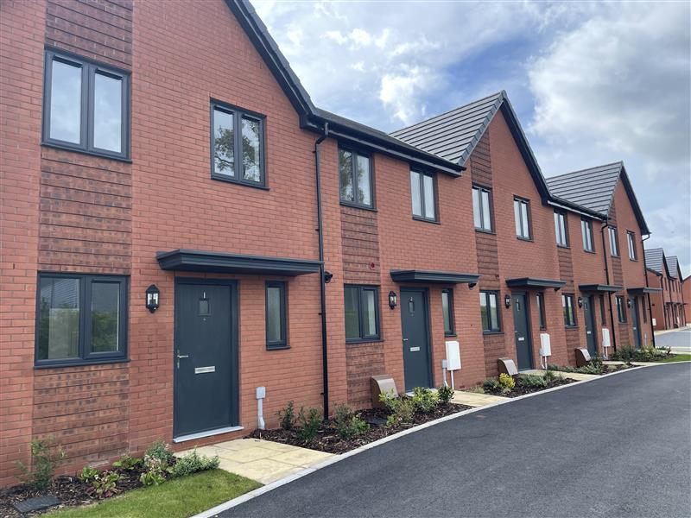

Morro Partnerships
Community Newsletter
Autumn 2024
Ben – we just got this Image from your web site – do you have a preferred image/images?
Image credit: Cambridge Road, Whetstone,
Morro Partnerships
House Type Image. Credit: Morro Partnerships Abbey Park Road Development
Welcome
Welcome to Morro Partnerships news, this is our Community Newsletter informing you first on proposals for our new development on brownfield land at Lightmoor Road, Little Dawley, Telford. It aims to keep residents updated on our latest plans for a new development on this brownfield site.
Our Plans
We are proposing to submit a detailed planning application for 52 dwellings this brownfield commercial site at Lightmoor Road, Little Dawley, Telford. We propose to redevelop the site for residential purposes to provide affordable rented housing for local people.
We’d like to know your views on the redevelopment and so we are setting out some information below.
About Us
Morro’s founding aim is to work with local authorities and housing providers to uncover key regeneration sites to provide a mix of property types to the benefit of local communities. For over 30 years, we have proudly been undertaking refurbishment and regeneration schemes for affordable and private houses. As a privately owned company, we strive to develop properties that are built to last and made to instantly feel like home.
We put ourselves into our customers’ shoes and get to know their wants and needs on a personal level to guarantee we build the best. With decades under our belt, we have become experts in knowing what residents, local authorities and social landlords need from their properties. It also means our wide knowledge and understanding of regional authority planning strategies and policies and local land conditions are second to none.
Forward Thinking Communications

Slide 2
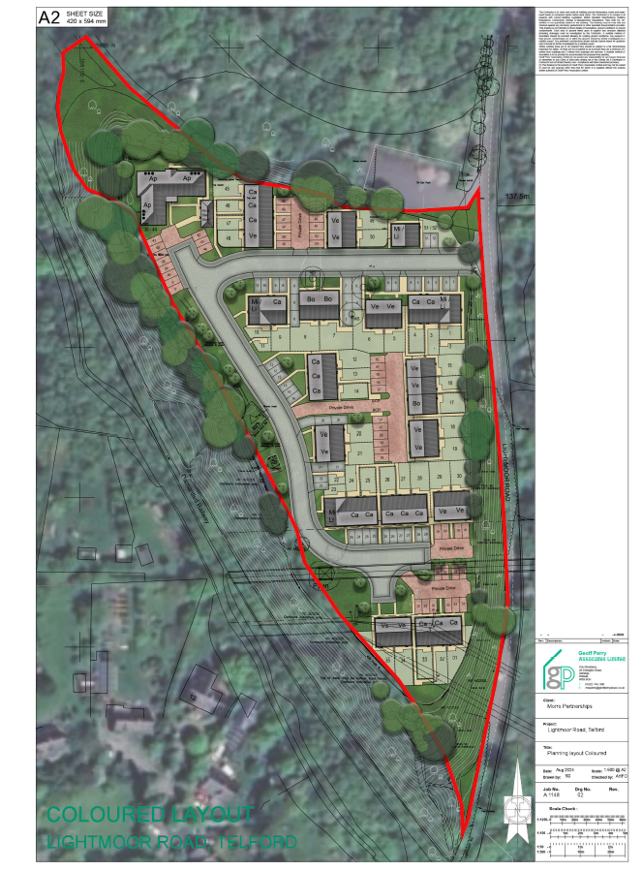
Morro Partnerships
Community Newsletter
AUTUMN 2024
SUMMER 2024
Our Proposed Site Layout
Confirm if using latest layout or old version….
GPA to provide without schedule on plan
Image Credit: Geoff Perry Associates
Our Proposed Layout….
We are seeking your views….
Forward Thinking Communications

Slide 3
Morro Partnerships
Community Newsletter
AUTUMN 2024
Development Features
Brownfield Site
This commercial site is designated as ‘white’ land by Telford & Wrekin Council and has not policy designations affecting it. We propose to change its use from industrial/commercial site to residential.
Affordable Housing
52 affordable rented dwellings.
Sustainability & Ecology
Provide biodiversity gains.
Sustainable building materials are used in the build, including a timber frame product that is sustainably sourced.
Bus stops & Pedestrian Links
The nearest bus stop is approx. 11 mins walk in Hazlewood Drive.
The development will also enable the upgrade of local pedestrian links.
Community Wellbeing
Promote health and well-being, to make places better for people and create safe environments.
Will be well-lit, safe and secure for future residents.
Will provide new attractive wildlife and landscaped areas
Economic Benefits
New apprenticeships will be created.
New jobs will be created in sales and construction relating to the development.
Access & Car Parking
All homes will have two dedicated car parking spaces.
What’s next?
We are inviting people to fill out our survey available at www.urbanissta.co.uk under the Public Access section.
Please complete the survey by the 11th December 2024
Having received all the survey feedback, we will review the comments made and address them in our planning submission.
Want to know more?
This newsletter has been sent to residents adjacent to the site as well as to local stakeholders.
If you have any questions or comments on the plans for this new community, please visit www.urbanissta.co.uk or email info@urbanissta.co.uk or call 0207 459 4549.
Forward Thinking Communications

